Slide 1


Investigation of Vulnerabilities in Open RAN Implementations
Research Project – WS 22/23
Arnova Abdullah
Weekly meeting-12 (18.01.2023)

Slide 2
Previous Weeks Meeting Details
Week 1 Meeting (19.10.2022)
Basics about Radio Access Network (History, parts of RAN for 1G, 2G, 3G, 4G)
Basics about Open RAN (Distribution unit, central unit, user plane, control plane, interfaces, front haul, mid haul, backhaul)
Open RAN risk analysis (Stakeholders of attackers-User, external attacker, cloud operator**, RAN operator**)
Week 2 Meeting (26.10.2022)
Installation of Kali Linux and Metasploitable
Atomic Red Team GitHub repository download
Research other open-source attack tools
Week 3 Meeting (02.11.2022)
Penetration testing using Kali Linux
Try Atomic tests by invoke-atomic
Get used to commands used for running a test
Research details about one of the attack tools - Infection Monkey
Read research papers on the risk of 5G open RAN
Week 4 Meeting (09.11.2022)
Finding the most relatable attacks from the MITRE ATTACK list (On going)
CyberOps course ongoing
Research paper by MOU

Slide 3

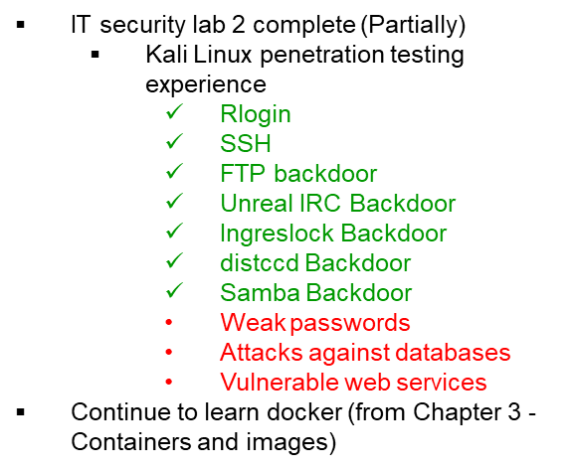

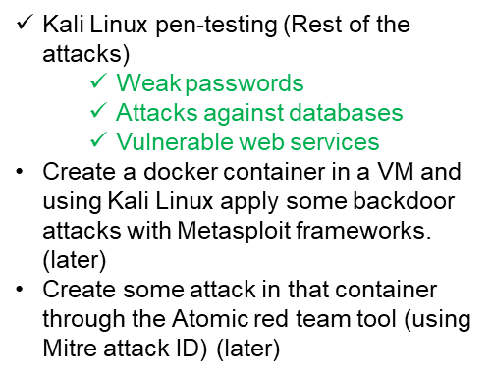
Previous Weeks Meeting Details
Week 5 Meeting (17.11.2022)
Install Infection monkey (Need AWS subscription, don’t continue anymore!!)
Start learning Docker container
https://developer.cisco.com/learning/tracks/containers/
https://learning.oreilly.com/videos/docker-fundamentals-for/9781803237428/9781803237428-video1_1/
Week 8 Meeting (08.12.2022)
Make a comparison between Kali Linux tools and Atomic Red Team
Select one to use at the end of the project
Week 9 Meeting (15.12.2022)
No update

Slide 4
Previous Weeks Meeting Details
Week 10 Meeting (21.12.2022)
Research:
Is there a map between MITRE ID to CVE list?
In Kali Linux, is there any tool or settings to map CVE or MITRE ID?
Create an extended comparison between Atomic and Kali in MS Excel (Not done yet)
Create a list for Docker, and Kubernetes attacks:
How to attack the docker container? Which version?
What are the tools? (If required any)
What are the known vulnerabilities? (CVE, MITRE)
Create a list for Ubuntu:
Which Ubuntu version?
How to attack Ubuntu?
What are the tools? (If required any)
What are the known vulnerabilities? (CVE, MITRE)
Week 11 Meeting (11.01.2023)
Research more about Vulmap.
Which type of attack can it do?
Install it in Kali Linux and have practical experience with it.
Do the lab of Docker from Devnet.
If it is installed, then try some attacks with kali and atomic by mapping to CVE/MITRE. Use the list from the previous page list. (Partially done!)

Slide 5
Week 12 Until 18.01.2023
Create a list of the MITRE ATT&CK ID by mapping to CVE ID
Follow the process described in https://github.com/center-for-threat-informed-defense/attack_to_cve/blob/master/methodology.md
Create your own environment with Ubuntu 20.04 and Kubernetes V1.16.0
Apply attacks with invoke-atomic with the MITRE ID mapped with CVE

Slide 6
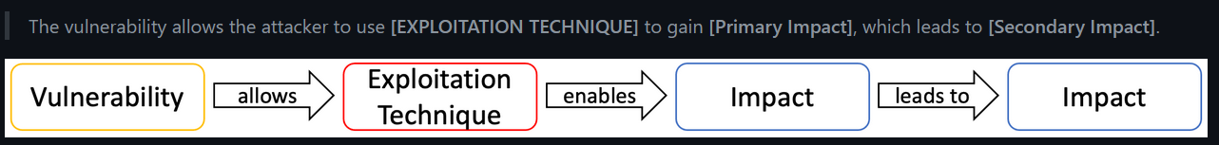
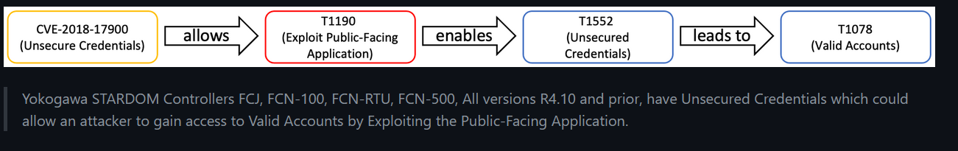
MITRE mapping to CVE
Three steps
Exploitation Technique - the method used to exploit the vulnerability
Primary Impact - the initial benefit gained through exploitation of a vulnerability
Secondary Impact - what the adversary can do by gaining the benefit of the primary impact
For example:

Slide 7
MITRE mapping to CVE
One CVE ID
Three MITRE ATT&CK ID

Slide 8
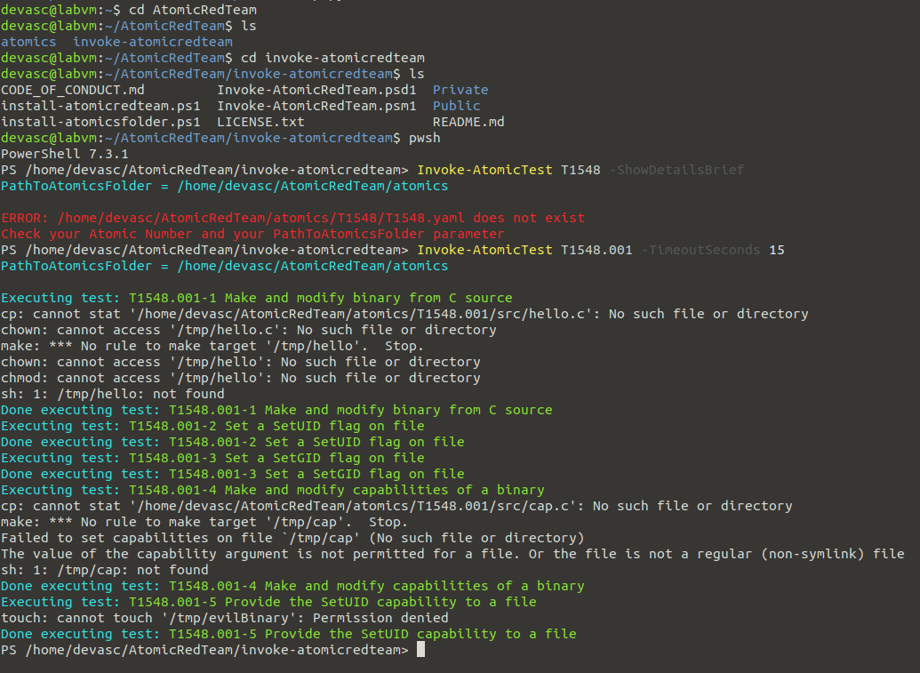
Practical attack
- Atomic Red Team

Slide 9
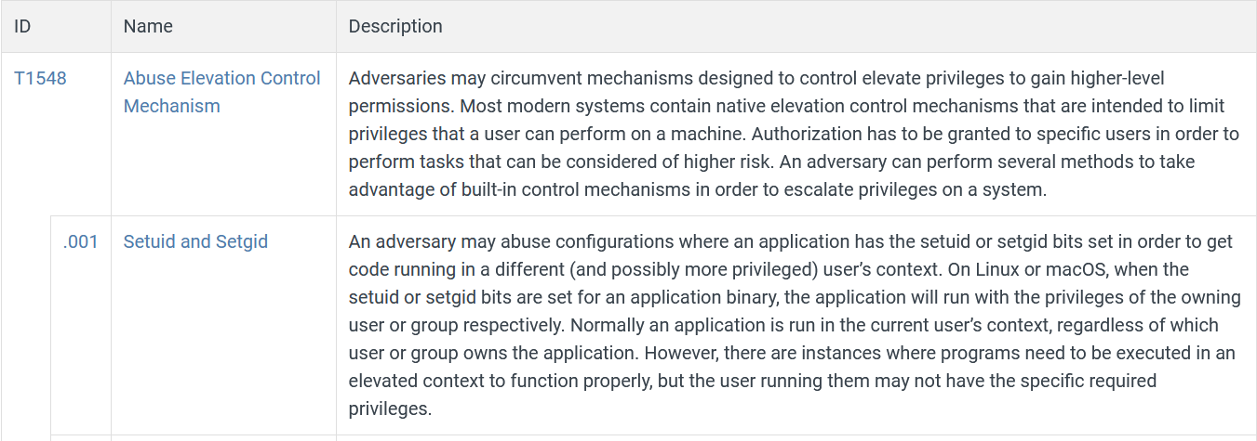
Practical attack
- Atomic Red Team
https://attack.mitre.org/techniques/T1548/001

Slide 10
Practical attack
- Atomic Red Team
Ubuntu 20.04 has 18 vulnerabilities (CVE ID)
Link: https://www.cvedetails.com/vulnerability-list/vendor_id-4781/product_id-20550/version_id-579251/opbyp-1/Canonical-Ubuntu-Linux-20.04.html
If each CVE ID maps to a minimum of 2 MITRE IDs, there will be 36 MITRE attack IDs to understand.
Example: (https://www.cvedetails.com/cve/CVE-2020-15780/)
CVE-2020-15780: An issue was discovered in drivers/acpi/acpi_configfs.c in the Linux kernel before 5.7.7. Injection of malicious ACPI tables via configfs could be used by attackers to bypass lockdown and secure boot restrictions, aka CID-75b0cea7bf30.
In this example: we may choose keywords to understand the tactics and techniques.
Tactic: To bypass lockdown and secure boot restrictions
Technique: Injection of malicious ACPI tables
In MITRE ATT&CK, there are no exact matches of these keywords, so we need to assume or try some attacks based on our assumption.

Slide 11
Next Steps (Week 13) Until 25.01.2023 (10:00 am)
Continue working on the mapping and practical attack..

